Slide 1

Vulcan Activity Tracker
CMSC-4920-SeniorProject2
Group 2
Margo Bonal
John Gerega
Luke Ruffing

Slide 2
Weekly Progress
Goals
Corrected Activity Table refreshing error, data can be seen immediately now
Set up the leaderboard page to extract user activities and filter them based on activity type or general statistics
Begin setup of the Clubs page
Display recent activities on the dashboard
Addition of Friends feature: user can view list available users and friends

Slide 3
Challenges & Solutions
Challenges
Solutions
Async function timing on Activity Table API
Owner could join their own club
Struggle to filter data on leaderboard based on activity type
User can’t add themselves as a friend
Duplicate Friends
Logic needed rearranged so table API triggered
Added column in schema to hold club creators User ID
No solution yet
Check user unique id from database, and remove from dropdown
Once friend is added, take off dropdown list
  Add to existing friend schema so next session friends are visible

Slide 4
Video Progress
Vulcan Platform
Database

Slide 5
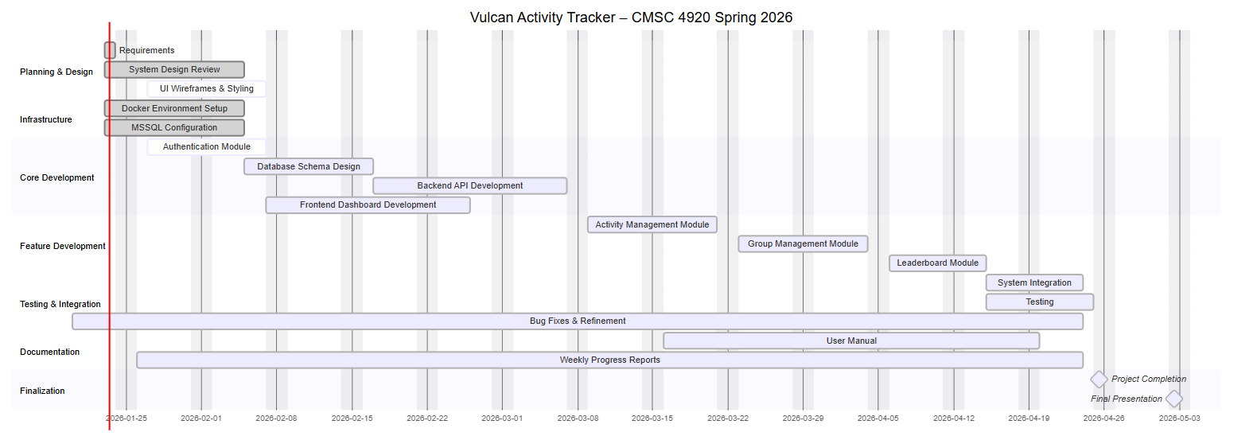
Gant Chart Progress

Slide 6
Team Week 4 Schedule:
Continue Clubs Page Development
Continue Leaderboard Page Development
Begin Challenges Page Development
View Friends Accounts

